Slide 1

Sara Hacheche Project
1. Define Virtualization 2. Discuss the benefits 3. How virtual machines work? 4. How does Azure works?

Slide 2
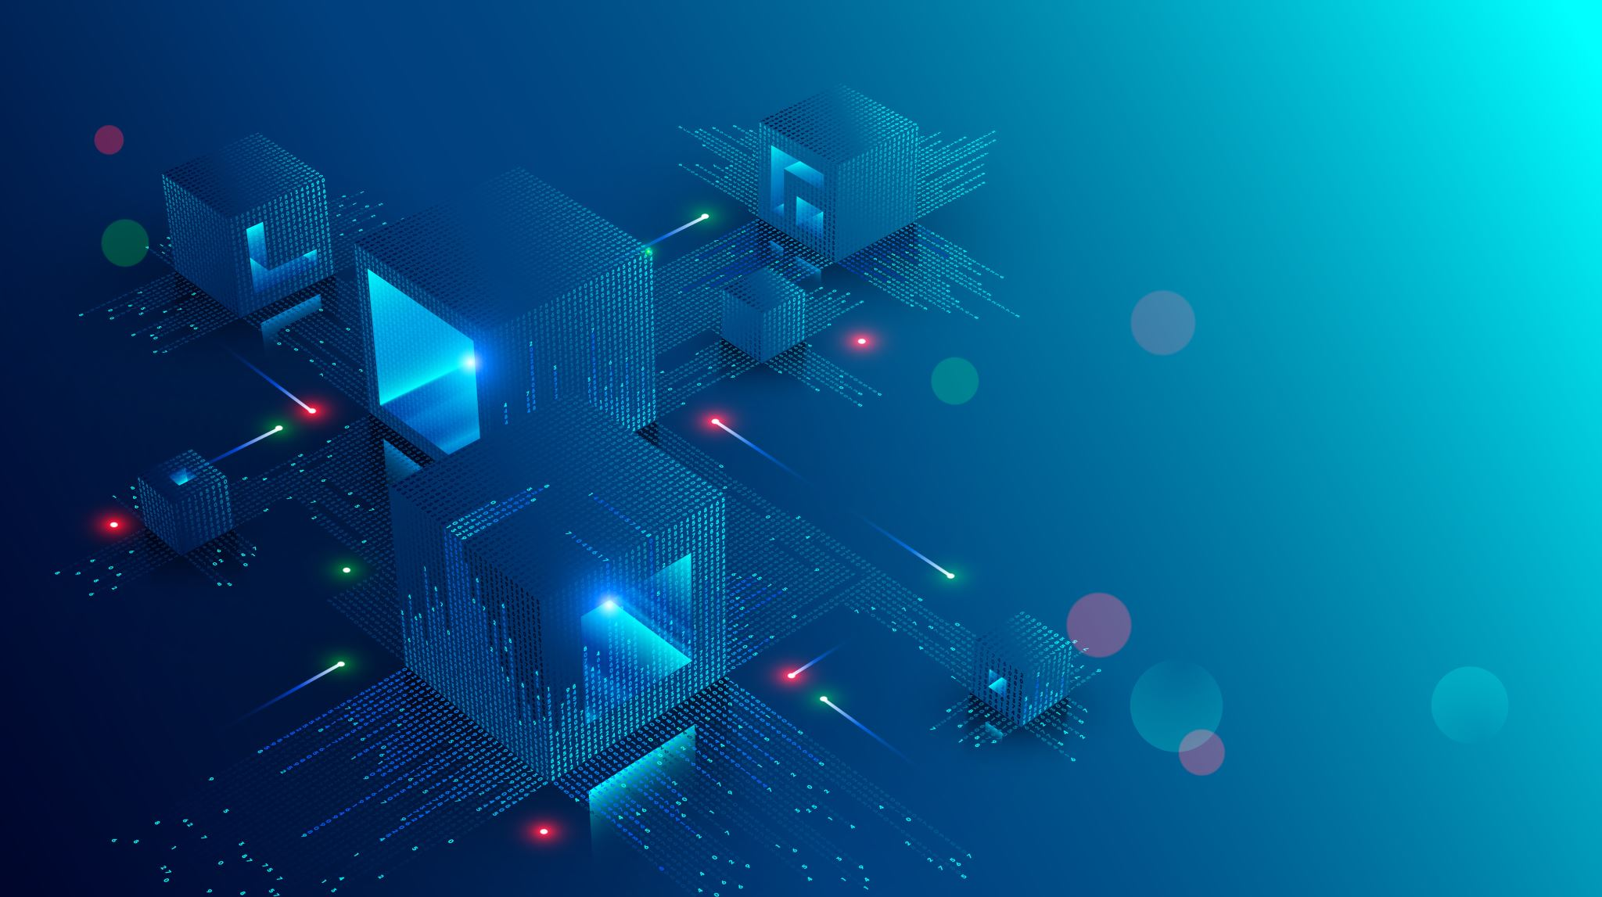
Virtualization
Virtualization is the process of creating a virtual version of something, such as a virtual computer hardware platform, storage device, or operating system. It involves abstracting and isolating computing resources from the underlying physical hardware, allowing multiple virtual environments (virtual machines) to run on a single physical machine. The software responsible for this abstraction is known as the hypervisor, which manages the allocation and sharing of resources among the virtual machines.

Slide 3

Benefits of Virtualization:
Cost Savings: By consolidating multiple virtual machines on a single physical server, businesses can reduce hardware costs and optimize resource utilization, leading to significant savings.

Slide 4

Benefits of Virtualization:
Flexibility and Scalability: Virtual machines can be easily provisioned, migrated, and scaled up or down as needed, providing greater agility for businesses.

Slide 5
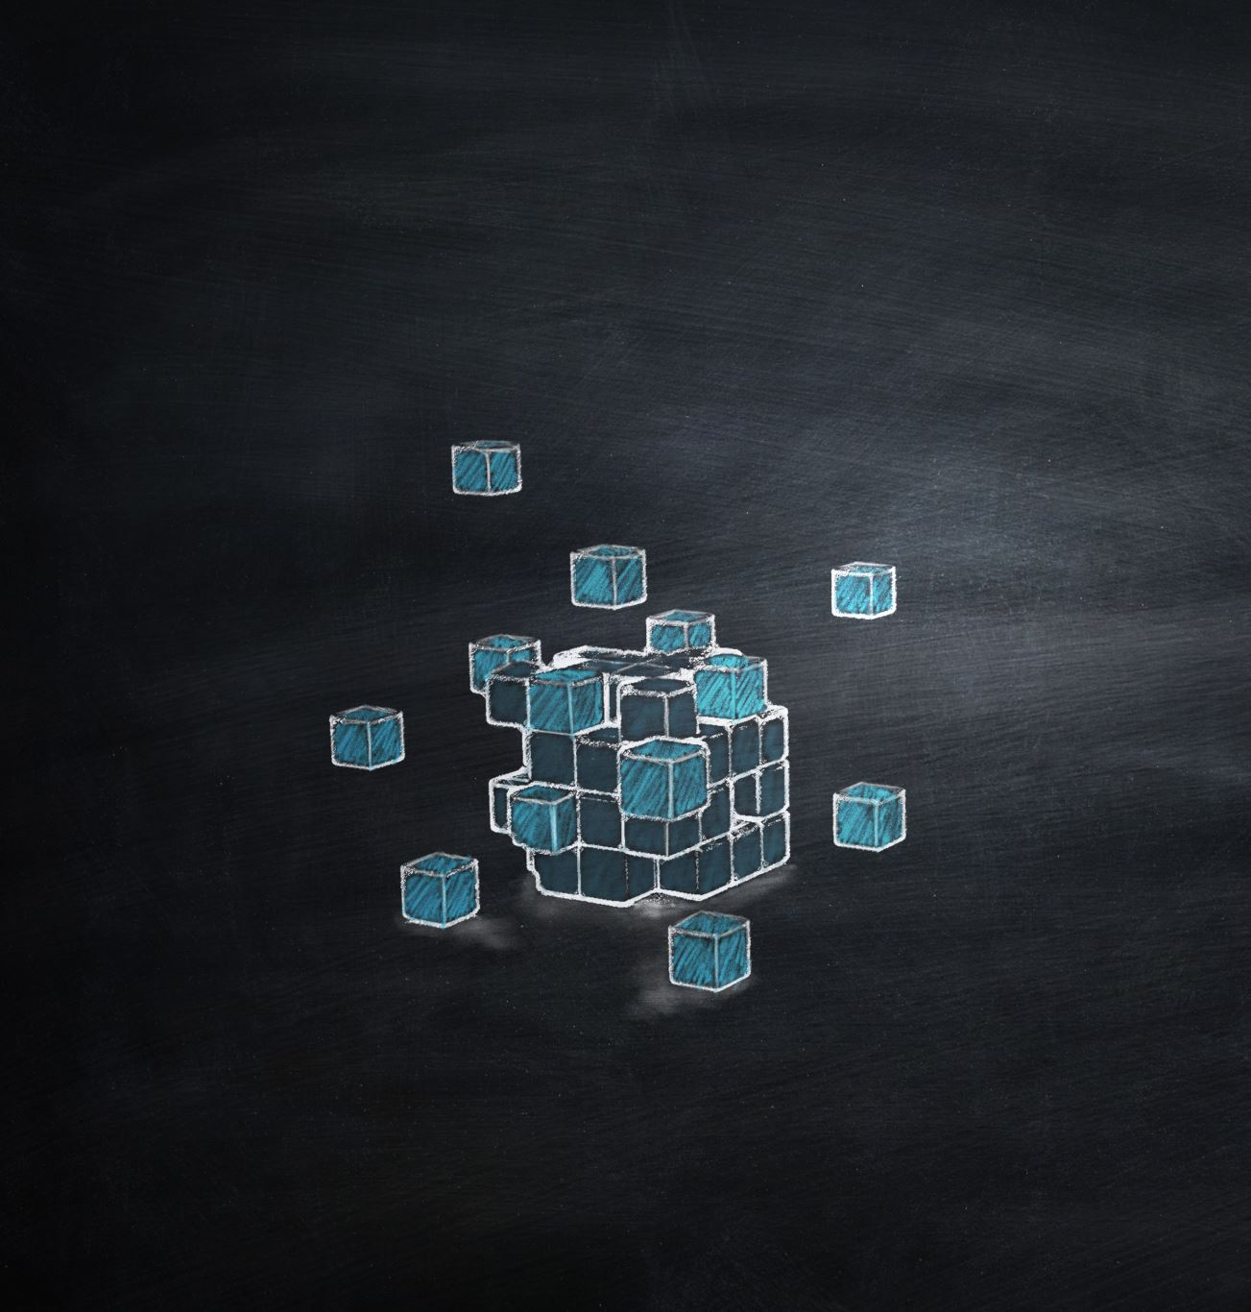
Benefits of Virtualization:
Testing and Development: Virtualization provides isolated and sandboxed environments for software testing and development, ensuring stability and minimizing risks in production environments.

Slide 6

Benefits of Virtualization:
High Availability: Virtualization allows for live migration of virtual machines between physical hosts, ensuring continuous availability and minimizing downtime during maintenance or hardware failures.

Slide 7

How Virtual Machines Work:
Virtual machines are created and managed by a hypervisor, a specialized software layer installed on the physical server. The hypervisor abstracts the underlying hardware, presenting each VM with a virtualized set of resources, including virtual CPUs, RAM, storage, and network interfaces. Each VM runs its own guest operating system, independent of other VMs and the host system.

Slide 8

What is Azure
The Azure cloud platform is more than 200 products and cloud services designed to help you bring new solutions to life—to solve today’s challenges and create the future. Build, run, and manage applications across multiple clouds, on-premises, and at the edge, with the tools and frameworks of your choice.

Slide 9


How Azure Works
Microsoft Azure is a cloud computing platform that provides a range of services, including virtualization capabilities. Azure's virtualization works based on the following components:

Slide 10

Azure Virtual Machines
Azure allows users to create and deploy virtual machines in the cloud. Users can select from a variety of pre-configured virtual machine images or create custom ones based on their needs. Azure VMs provide flexibility, scalability, and pay-as-you-go pricing.

Slide 11

Azure Virtual Networks
Virtual networks in Azure enable users to create isolated network environments, just like they would in an on-premises data center. Users can define subnets, security groups, and network gateways to control traffic flow and secure communication between resources.

Slide 12

Azure Backup and Disaster Recovery
Azure offers various backup and disaster recovery solutions to protect virtualized workloads and ensure business continuity in case of emergencies.

Slide 13

My references
https://www.parallels.com/blogs/ras/virtual-machine/
https://azure.microsoft.com/en-us/resources/cloud-computing-dictionary/what-is-azure/
These are just a few aspects of how Azure leverages virtualization
Thank you .

